Slide 1

Problem Statement and Team Details
Problem Statement: Safety object detection
Team Name: AI INNOVATORS
Team Leader Name: MOHAMMAD ASIF BAIG
Institute Name:
Team Leader Email ID: mohammadasifbaig87@gmail.com
SESHADRI RAO GUDLAVALLERU ENGINEERING COLLEGE

Slide 2
Safety Object Detection is an AI-based system that uses computer vision and deep learning to automatically identify safety equipment such as helmets, vests, gloves, and fire extinguishers in real time. The problem it addresses is that manual safety monitoring is slow, error-prone, and often fails to prevent accidents when workers don’t wear or correctly use safety gear. The solution is to deploy a deep learning model integrated with cameras to continuously detect safety objects, send instant alerts on violations, and store data for compliance reporting, thereby improving workplace safety and reducing human error.
Safety Object Detection

Slide 3
Methodology & Implementation
Our approach to Safety Object Detection involves four main steps. First, we collect and label images of safety equipment such as helmets, vests, gloves, and fire extinguishers to build a diverse dataset. Second, we train a deep learning object detection model (YOLO/Faster R-CNN) on this dataset to accurately recognize safety objects. Third, we integrate the trained model with real-time camera feeds to automatically detect safety gear and hazards. Finally, we implement an alert and reporting system that immediately notifies supervisors of violations and stores the data for compliance analysis. This step-by-step implementation ensures accurate detection, real-time monitoring, and improved workplace safety.

Slide 4
Technologies Used
Programming Language: Python (for AI/ML development)
Deep Learning Frameworks: TensorFlow / PyTorch
Object Detection Models: YOLOv5 / Faster R-CNN / SSD
Data Annotation Tools: LabelImg / Roboflow (for labeling images)
Computer Vision Library: OpenCV (for image & video processing)

Slide 5
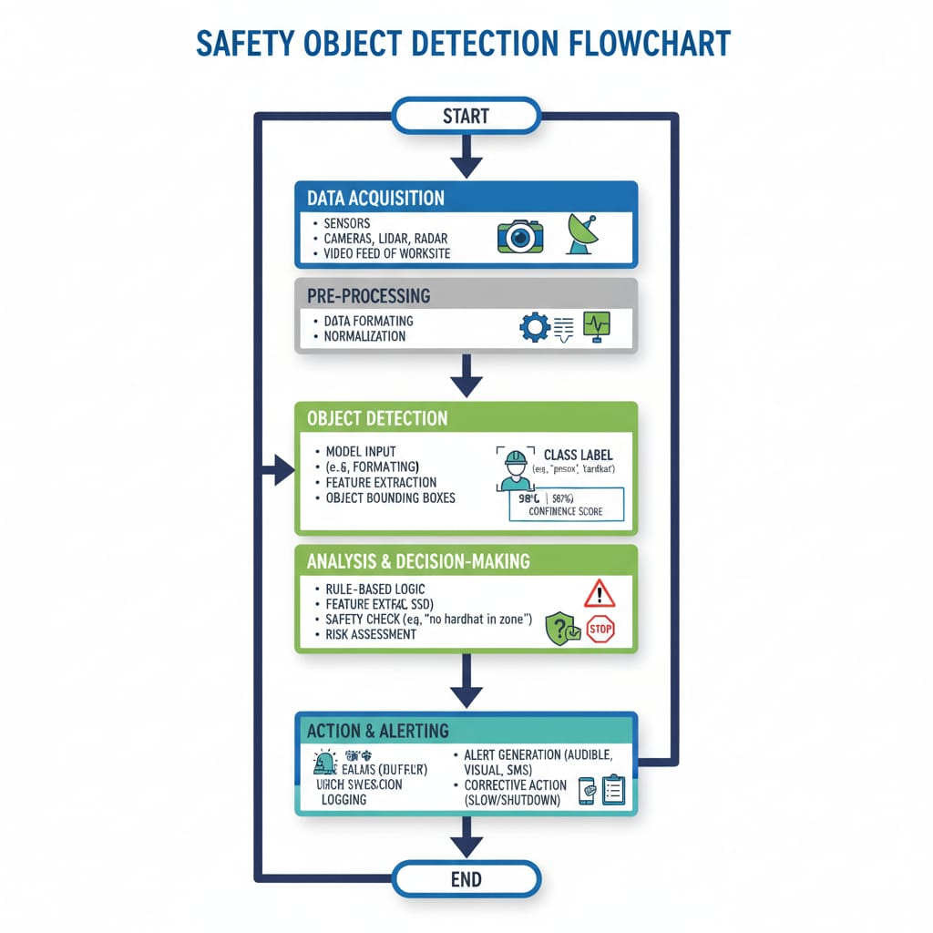

Slide 6
Feasibility and Market use
The Safety Object Detection system is highly feasible because it relies on affordable and widely available technologies such as CCTV cameras, open-source AI frameworks (TensorFlow, PyTorch), and edge/cloud deployment. Pre-trained models reduce development time and cost, and the system can be easily integrated into existing security and monitoring infrastructures in workplaces.
This system can be implemented in:
Construction & Infrastructure Sites – Monitoring helmets and safety vests.
Manufacturing Plants – Ensuring protective gear usage near machinery.
Warehouses & Logistics – Detecting fire extinguishers and safety signs.
Oil & Gas / Chemical Plants – Real-time monitoring of hazardous zones.
Public Transport & Large Venues – Safety compliance at airports, metros, and events.

Slide 7
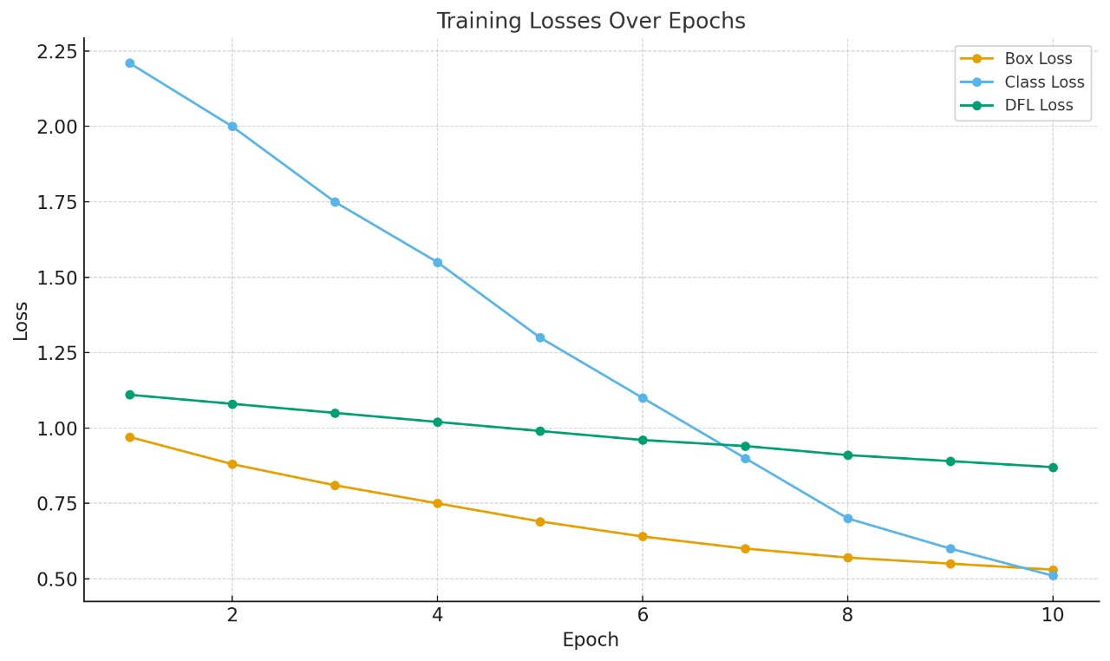
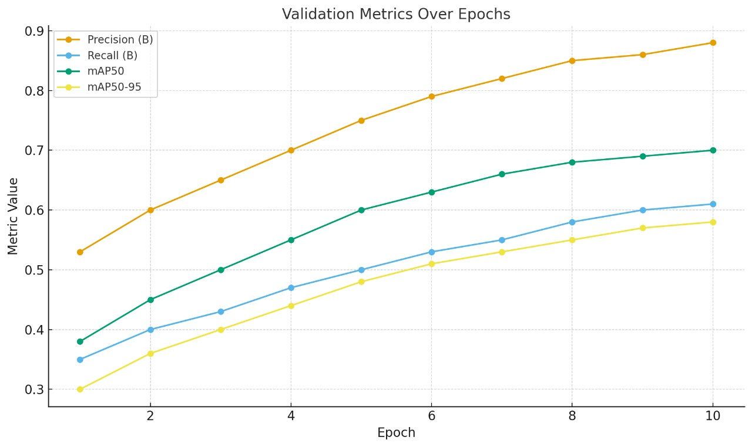
Results:
Box Loss dropped from 0.97 → 0.53
Class Loss dropped from 2.21 → 0.51
DFL Loss dropped from 1.11 → 0.87
Precision (B): improved from 0.53 → 0.88
Recall (B): improved from 0.35 → 0.61
mAP50: jumped from 0.38 → 0.70

Slide 8
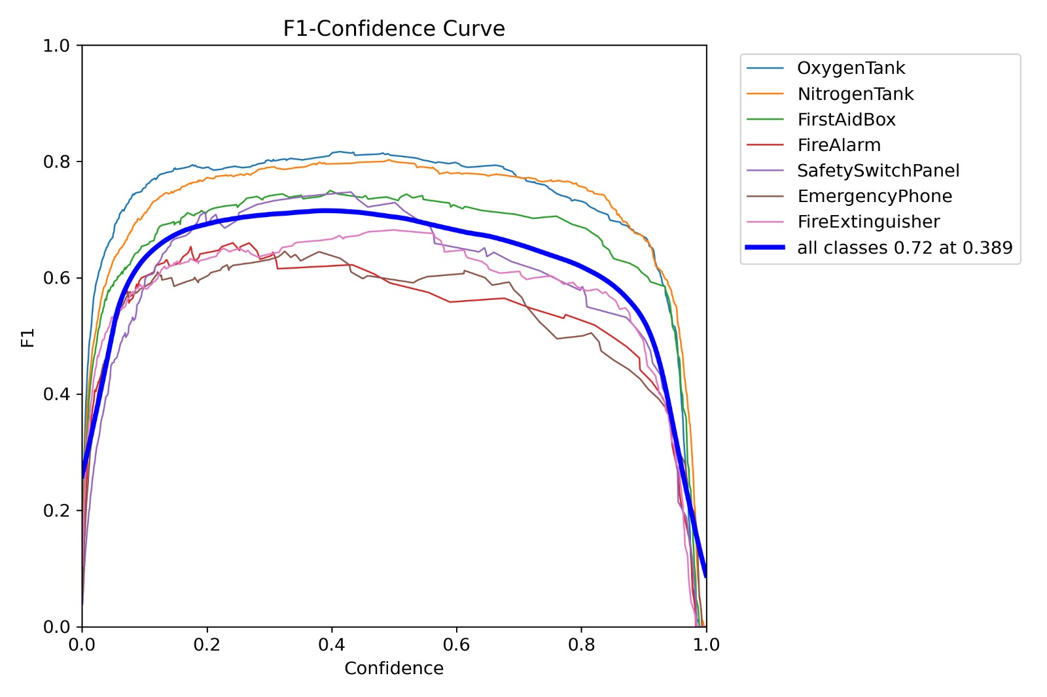
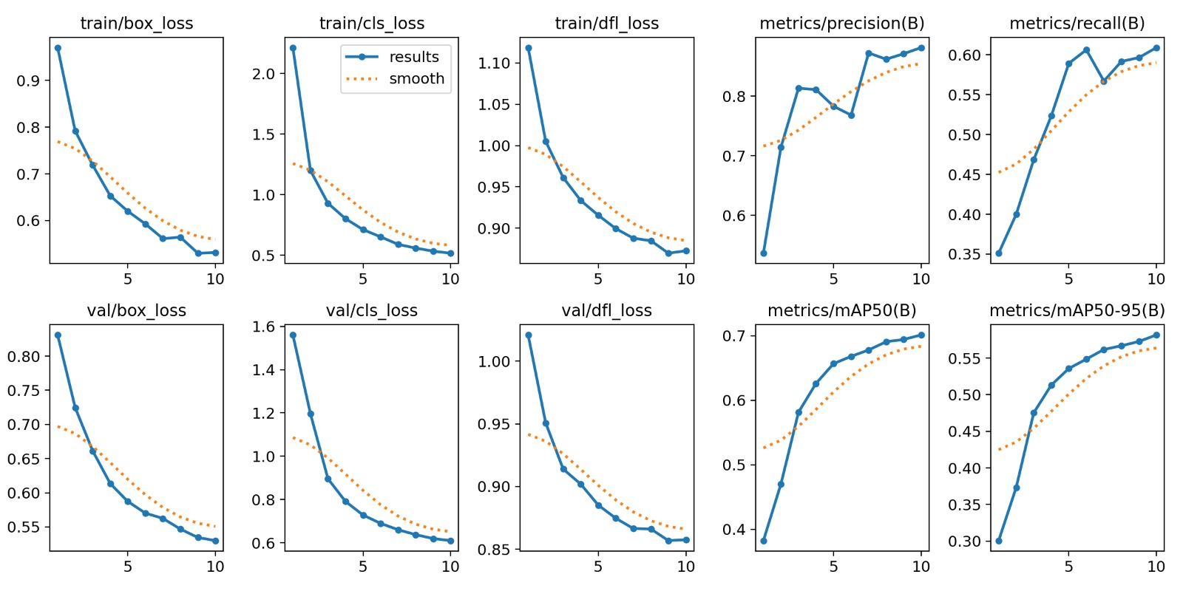
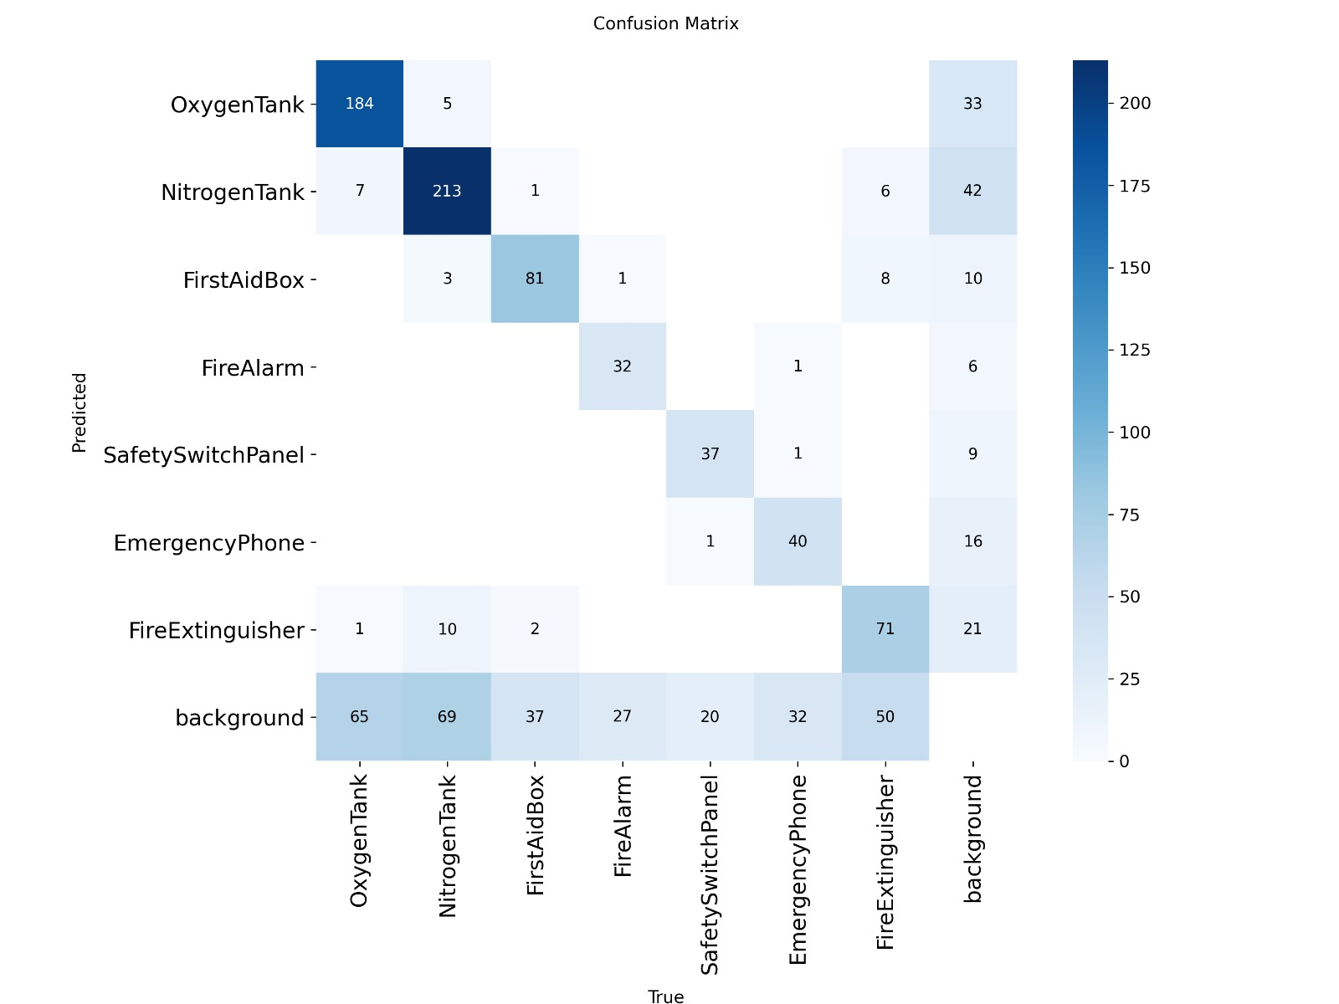
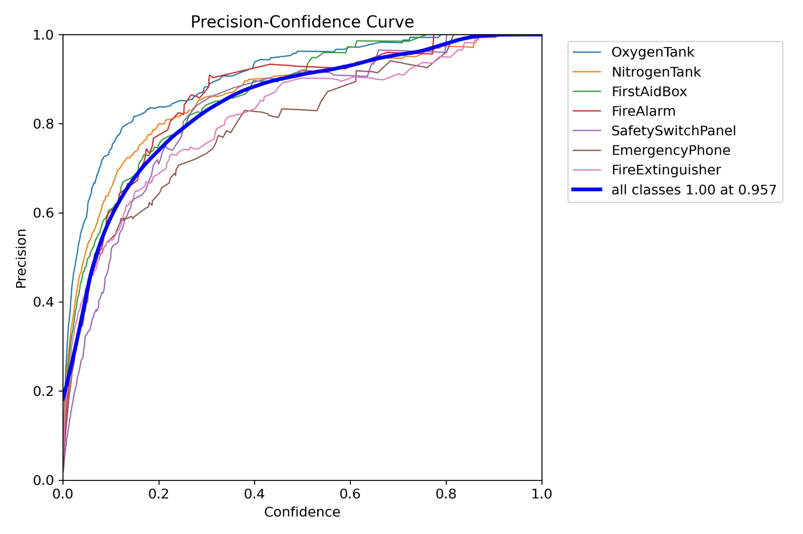
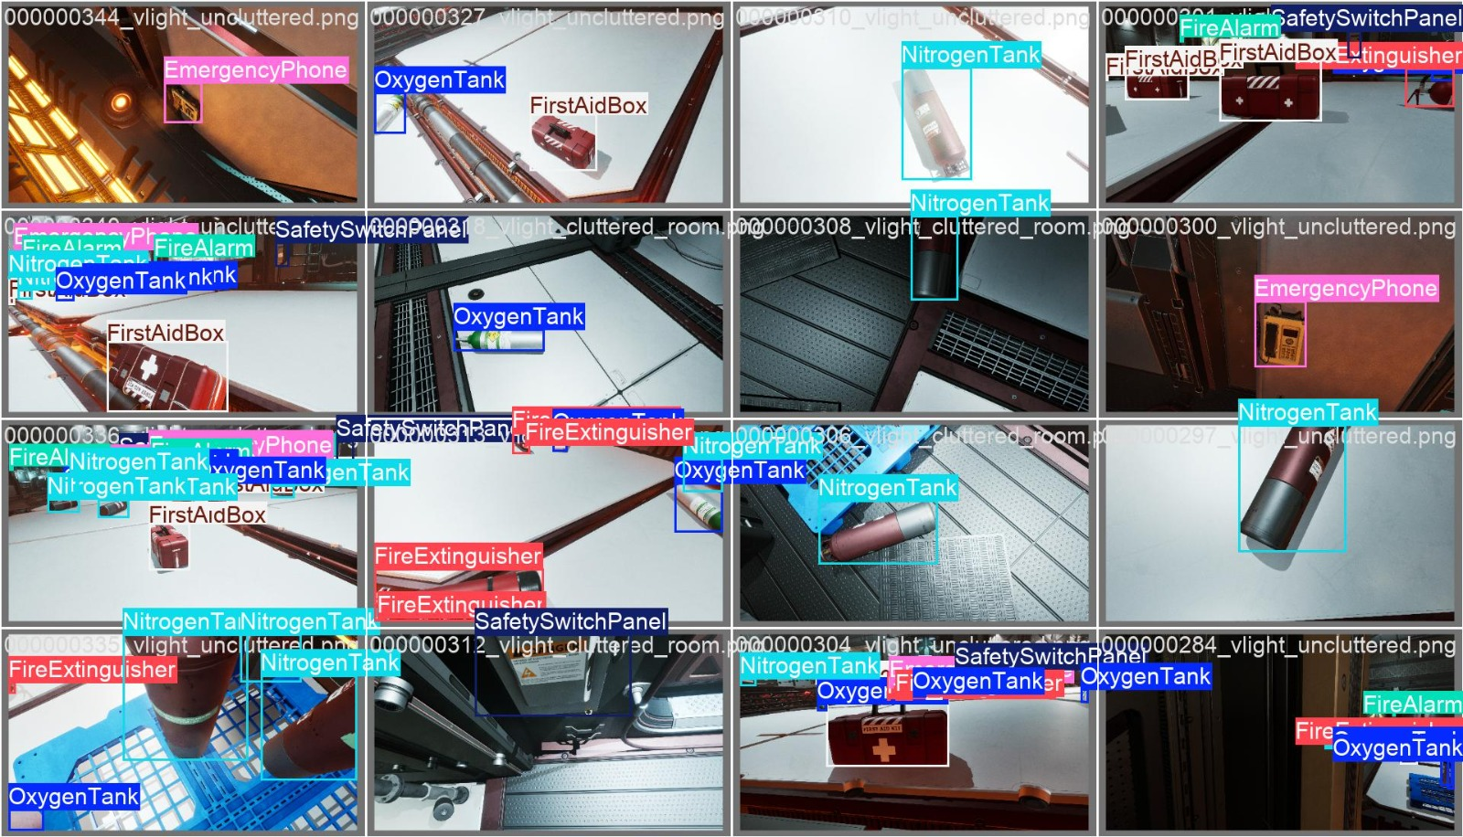
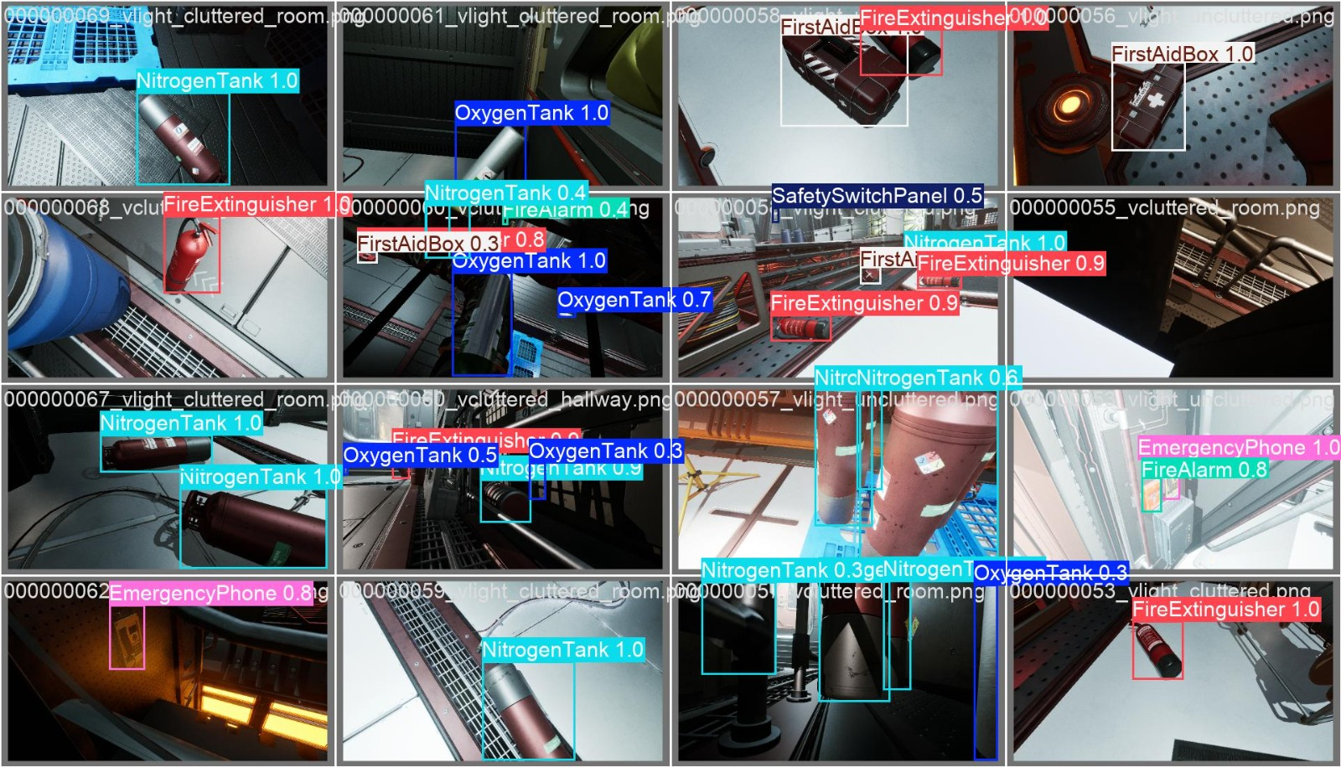
Prediction Result

Slide 9
Conclusion
The Safety Object Detection system demonstrates how AI and computer vision can transform workplace safety by providing real-time monitoring, automatic detection of safety equipment, and instant alerts for violations. By reducing human error, ensuring compliance with regulations, and preventing accidents, this solution offers a cost-effective and scalable approach to improving safety standards across industries. Its adaptability and integration with existing infrastructure make it a practical and future-ready tool for organizations committed to maintaining a safe and compliant work environment.

